Slide 1
Data Analytics
Case Study
Megan Goldsworthy
2023

Slide 2
Main Question
Our stakeholder wants to purchase an Airbnb to make extra money.
-Where should he purchase?
- How big of a home should he buy?
- When should he rent for maximum profit?

Slide 3
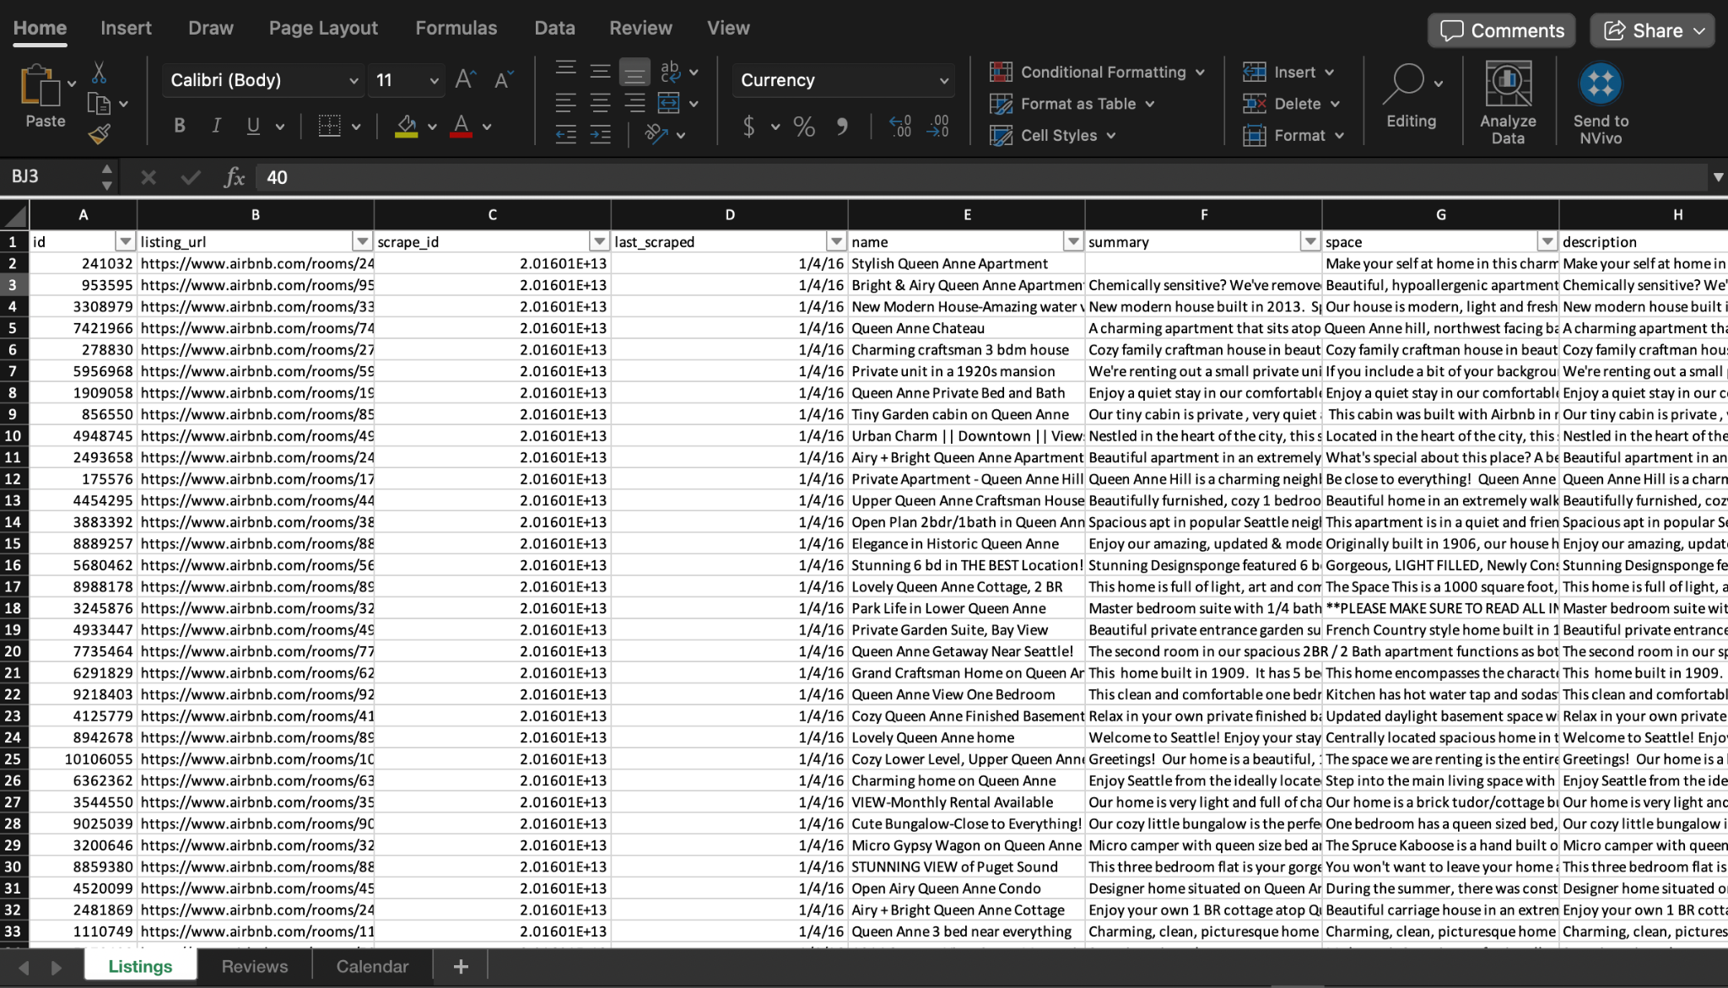
The Data
Open source data taken from Kaggle.com/airbnb/seattle shows data for AirBnb rentals in the Seattle area in 2016.
Then I uploaded into excel.
The data set includes listings, prices, number of bedrooms, locations, addresses, reviews, listing ids, etc.

Slide 4
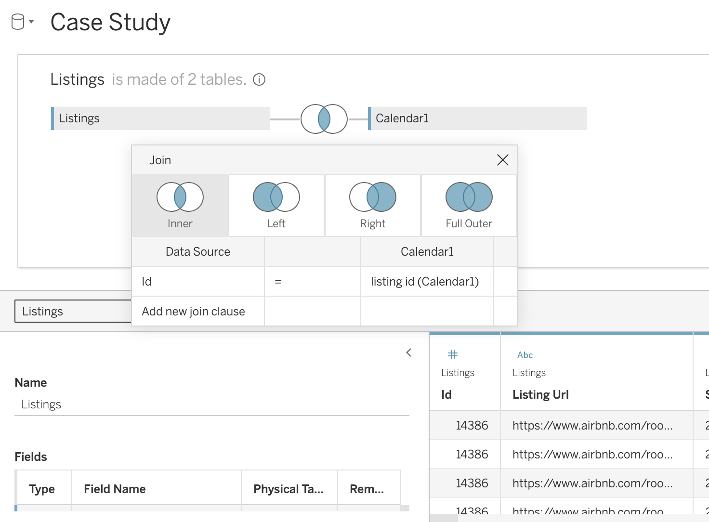
Cleaning
I removed any rows with duplicate data and any with missing or null data. Where appropriate, rows were removed for listings with 0 bedrooms.
Next, I uploaded the data sets into Tableau and joined the ‘listings’ and ‘calendar’ sheets by the rental IDs. This allowed me to compare the prices of the AirBnbs with the dates they were rented.

Slide 5
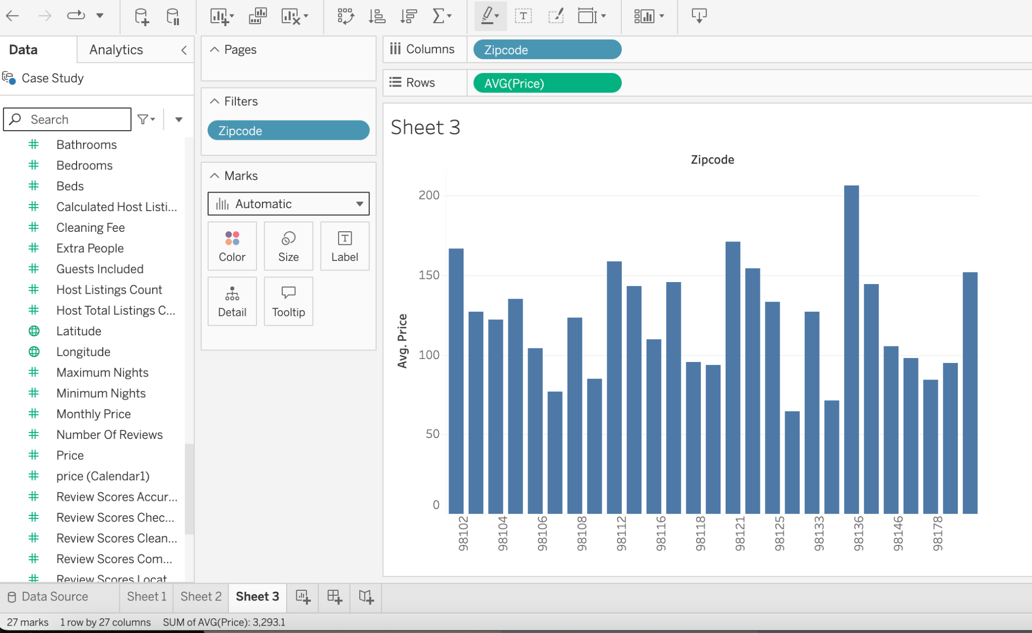
Visualization
Using Tableau to create data visualizations, I can begin to process the relationships between various factors, such as price and area.
Another important trend to examine is what type of renals are people using. Does the number of bedrooms affect the profit?

Slide 6
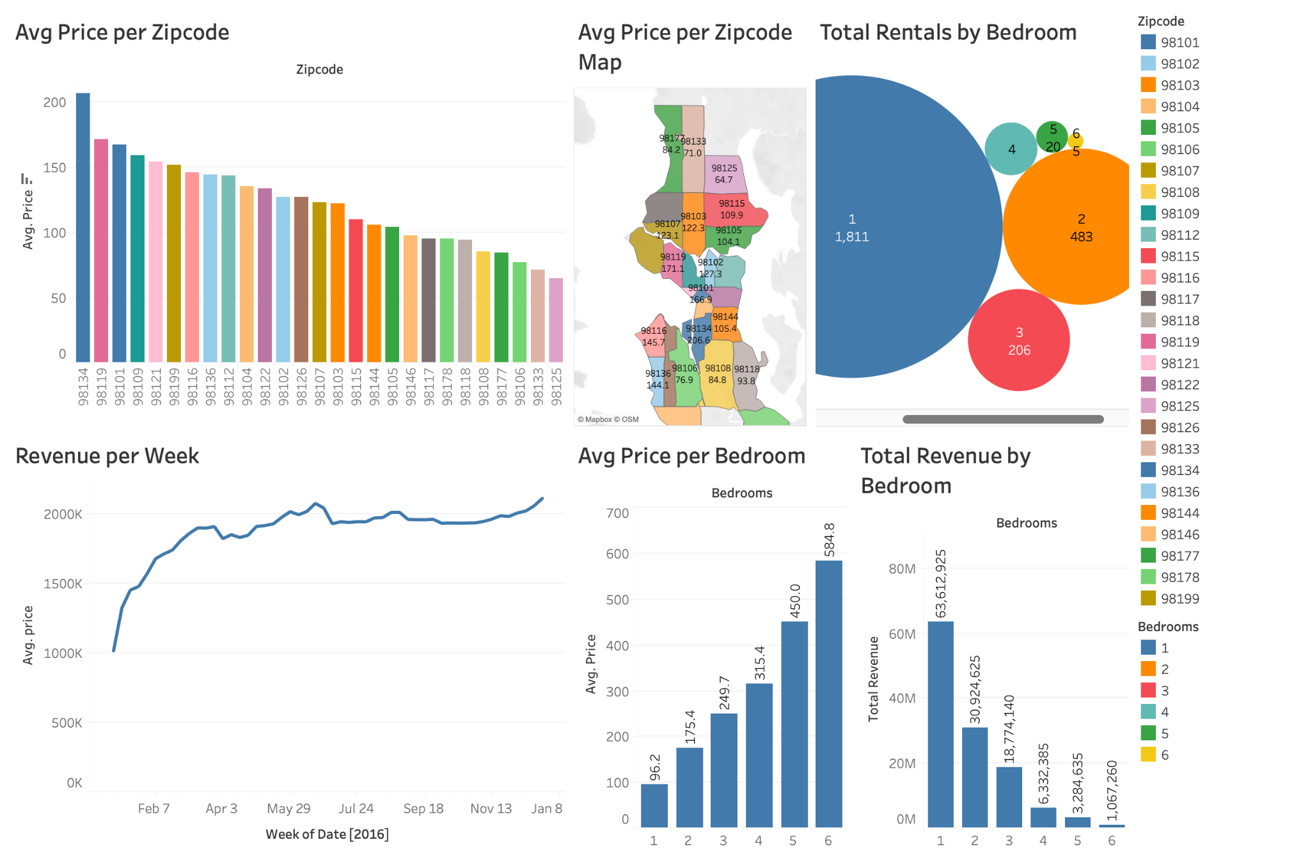
Dashboard
Dashboard visible at https://public.tableau.com/app/profile/megan.goldsworthy/vizzes

Slide 7
Takeaways for Stakeholder
The most profitable zip codes to list AirBnbs include…
Our stakeholder should avoid purchasing a one bedroom in order to differentiate himself from the majority on the market.
The more bedrooms a rental has, the higher the price is per night, allowing our stakeholder to charge more, increasing his return on investment.
The most popular time for AirBnb rentals is over the summer, including the months June, July and August, therefore, rental prices increase during these months.

